Slide 1
Syntax Directed Translation Compiler Design 14CS73 Unit 3
Dr. Saroja Devi

Slide 2
Unit 3 portion
Syntax Directed Translation& Intermediate code generation: Syntax directed translation schemes & implementations
Intermediate code, Syntax trees, DAG for expressions, Three address code, quadruples, triples, Translation of expressions, Control flow, Backpatching, Switch statements, Intermediate code for procedures.

Slide 3
Preview
Syntax directed translation uses the parse tree and generates intermediate code. Grammar rules are attached to the productions here.
A syntax-directed definition (SDD) is a context free grammar with attributes & rules.
A SDD adds semantic rules to the productions of a grammar. For example:
to the production T → T1 / F we might add the rule for division as
T.code = T1.code || F.code || '/‘ for an infix to postfix translator.
Rather than constantly copying ever larger strings to finally output at the root of the tree after a depth first traversal, we can perform the output incrementally by embedding semantic actions within the productions themselves.
The above example becomes T → T1 / F { print '/' } Since we are generating postfix, the action comes at the end (after we have generated the subtrees for T1 and F, and hence performed their actions). In general the actions occur within the production, not necessarily after the last symbol.

Slide 4
SDT and SDD
SDT (syntax directed translation scheme) refers to a method of compiler implementation where the source language translation is driven by the parser. The parsing process and parse trees are used to direct the semantic analysis and the translation of the source program.
SDT is a context free grammar with program fragments (sematic actions shown within curly braces) embedded within production bodies.
Two ways to represent the semantic rules associated with grammar symbols : SDD & SDT

Slide 5
SDD VS SDT
SDD | SDT
Grammar with attributes and rules | Grammar with attributes & actions in the form of program fragments.
Highly readable and gives high level specification for translation | Less readable, more clear, gives program fragments called semantic actions.
Hide many implementation details, like order of evaluation of semantic action. Less efficient. | Efficient and indicate the order of evaluation of semantic actions.

Slide 6
SDD attributes
SDD attributes are associated with grammar symbols and rules are associated with productions. If X is a symbol and a is one of its attributes, then we write X.a to denote the value of a at a particular parse tree node X. Attributes may be of any kind: numbers, types, table references, or strings, for instance.
Inherited and Synthesized Attributes: There are no rules in an SDD giving values to attributes for terminals. Terminals do not have inherited attributes. A nonterminal A can have both inherited and synthesized attributes.
Synthesized attribute for a nonterminal A at a parse-tree node N is defined by a semantic rule associated with the production at N. Note that the production must have A as its head. A synthesized attribute at node N is defined only in terms of attribute values at the children of N and at N itself.
An inherited attribute for a nonterminal B at a parse-tree node N is defined by a semantic rule associated with the production at the parent of N. Note that the production must have B as a symbol in its body. An inherited attribute at node N is defined only in terms of attribute values at N's parent, N itself, and N's siblings.

Slide 7
SDD of a simple desk calculator
Production | Semantic Rules
1.L → E n | L.val = E.val
2.E → E1 + T | E.val = E1.val + T.val
3.E → E1 - T | E.val = E1.val - T.val
4.E → T | E.val = T.val
5.T → T1 * F | T.val = T1.val x F.val
6.T → T1 / F | T.val = T1.val / F.val
7.T → F | T.val = F.val
8.F → ( E ) | F.val = E.val
9.F → digit | F.val = digit.lexval
Expressions with +, -, * , / are evaluated.
The SDD evaluates expressions terminated by an endmarker n. In the SDD, each of the nonterminals has a single synthesized attribute, called val . We also suppose that the terminal digit has a synthesized attribute lexval, which is an integer value returned by the lexical analyzer.
The last production gives F.val the value of digit, i.e.,numerical value of the token digit.

Slide 8
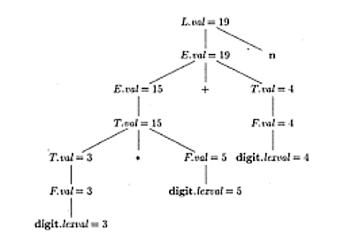
Annotated Parse tree: bottom up (synthesized attributes)
Annotated parse tree for 3*5+4n
Rules of SDD are applied by constructing parse tree and then using the rules to evaluate all of the attributes at each of the nodes of the parse tree. A parse tree showing the values of attributes is called annotated parse tree.
The values of lexval are presumed supplied by the lexical analyser.
With synthesized attributes we can evaluate attributes in any bottom up order, with a post order traversal of the parse tree.

Slide 9
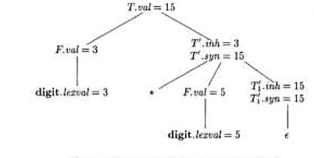
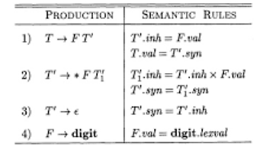
Annotated parse tree with inherited attributes for top down parsing
Annotated parser tree for 3*5
Inherited attributes are useful when the structure of a parse tree does not match the abstract syntax of the source code.
The top down parse of input 3*5 begins with production T->FT’. Here F generates digit 3, in a different subtree. Operator * is generated by T’, which is inherited.
Each of the nonterminals T &F has a synthesized attribute lexval. T’ has both inh and syn attributes.
T’ of the production T’->*FT1’ inherits the left operand of * in the production body. Given a term x*y*z, the root of the subtree for *y*z inherits x. Then the root of the subtree for *z inherits value for x*y.
With T’.inh=3 & F.val=5, we get T1’.inh=15. At the lower node for T1’the production is T’->ϵ. The semantic rule T’.syn=T’.inh defines T1’.syn=15. The syn attributes at the nodes for T’ pass the value 15 up to node for T, where T.val=15.
(semantic rule with production 1)
(rule 2)
(production 4)
SDD based on grammar suitable for top down parsing

Slide 10
Top down parsing with SDD for ex:3*5
The leftmost leaf in the parse tree, labeled digit, has attribute value lexval = 3, where the 3 is supplied by the lexical analyzer. Its parent is for production 4, F -> digit. The only semantic rule associated with this production defines F.val = digit.lexval, which equals 3.
At the second child of the root, the inherited attribute T'.inh is defined by the semantic rule T'.inh = F.val associated with production 1. Thus, the left operand, 3, for the * operator is passed from left to right across the children of the root.
The production at the node for T' is T' -> * FT₁’. (We retain the subscript 1 in the annotated parse tree to distinguish between the two nodes for T'.) The inherited attribute T₁’.inh is defined by the semantic rule T₁‘.inh = T'.inh x F.val associated with production 2.
With T'.inh = 3 and F.val = 5, we get T₁’.inh = 1 5 . At the lower node for T₁’ the production is T’ ->ϵ. The semantic rule T'.syn -> T'.inh defines T₁’.syn -> 15. The syn attributes at the nodes for T’ pass the value 15 up the tree to the node for T, where T.val = 15.

Slide 11
Applications of SDT
Type checking
Intermediate code generation
Construction of syntax trees: S attributed definition for bottom up parsing; L attributed definition for top down parsing.
SDD is S-attributed if every attribute is synthesized.
SDD is L-Attributed if each attribute is either
Synthesized.
Inherited “from the left”, and hence the name L-attributed. If the production is A → X1X2...Xn, then the inherited attributes for Xj can depend only on
a. Inherited attributes of A, the LHS.
b. Any attribute of X1, ..., Xj-1, i.e. only on symbols to the left of Xj.
Attributes of Xj,

Slide 12
Constructing Syntax trees
A syntax-tree node representing an expression E1+ E2 has label + and two children representing the subexpressions E1 and E2.
We implement the nodes of a syntax tree by objects with a suitable number of fields. Each object will have an op field that is the label of the node. The objects will have additional fields as follows:
If the node is a leaf, an additional field holds the lexical value for the leaf. A constructor function Leaf (op, val) creates a leaf object. Alternatively, if nodes are viewed as records, then Leaf returns a pointer to a new record for a leaf.
If the node is an interior node, there are as many additional fields as the node has children in the syntax tree. A constructor function Node takes two or more arguments: Node(op,c1,c2,... ,ck) creates an object with first field op and k additional fields for the k children c1,... , ck.

Slide 13
Constructing syntax trees for simple expressions: S attributed SDD(bottom up)
Production | Semantic Rules
1) E -> E1 + T | E.node = new Node(‘+’, E1.node, T.node)
2) E -> E1 - T | E.node = new Node(‘-’, E1.node, T.node)
3) F -> T | E.node = T.node
4) T -> ( E ) | T.node = E.node
5) T -> id | T.node = new Leaf(id, id.entry)
6) T -> num | T.node = new Leaf(num, num.val)
Steps in construction of the syntax tree for a-4+c :
p1 = new Leaf(id, entry-a);
p2 = new Leaf(num, 4);
p3 = new Node(‘-’, p1, p2);
p4 = new Leaf(id, entry-c);
p5 = new Node(‘+’, p3, p4);

Slide 14
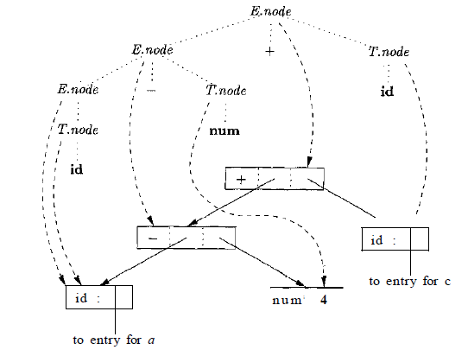
SDT generated Syntax tree for a-4+c

Slide 15
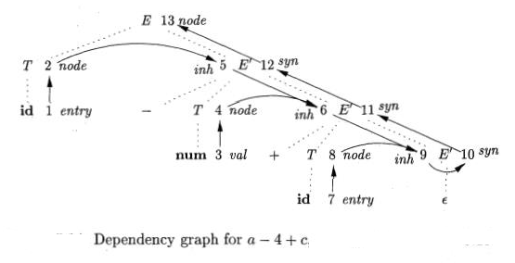
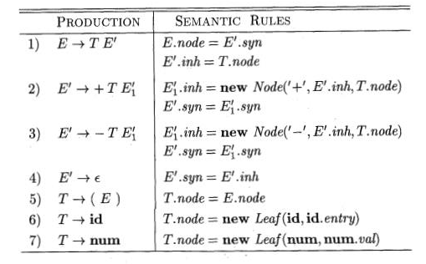
Constructing trees with top down parsing: L attributed definition (SDD)
Nodes are numbered 1 to 13 below.
SDD for top down syntax tree
a
a-4
a-4+c
Both S and L attributed definitions produce the same translations.

Slide 16
Top down parsing using L attributed definition ex:a-4+c
A term x+y is evaluated by passing x as inherited attribute since x and +y appear in diff.portions of the parse tree.
Nonterminal E' has an inherited attribute inh and a synthesized attribute syn. Attribute E'.inh represents the partial syntax tree constructed so far. E' represents the root of the tree for the prefix of the input string that is to the left of the subtree for E'.
At node 5 in the dependency graph in E'.inh denotes the root of the partial syntax tree for the identifier a in the input string, i.e, the leaf for a.
sAt node 6, E'.inh denotes the root for the partial syntax tree for the input a-4.
At Node 9 E'.inh denotes the syntax tree for a-4+c

Slide 17
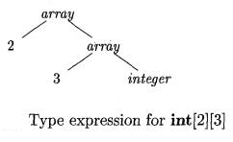
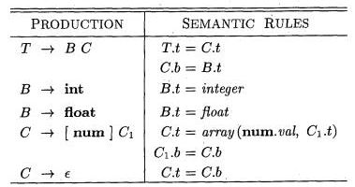
Array Types
In C, the type int [2][3] can be read as, "array of 2 arrays of 3 integers." The corresponding type expression array(2, array(3, integer)) is represented by the tree. The operator array takes two parameters, a number and a type. If types are represented by trees, then this operator returns a tree node labeled array with two children for a number and a type.
With the SDD, nonterminal T generates either a basic type or an array type. Nonterminal B generates one of the basic types int and float. T generates a basic type when T derives B & C and C derives ϵ. Otherwise, C generates array components consisting of a sequence of integers, each integer surrounded by brackets.

Slide 18
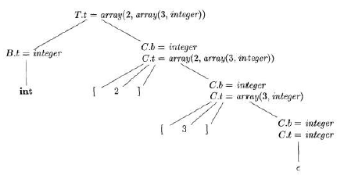
Annotated parse tree for array types
Syntax directed translation of array int [2][3]
At the root for T -> B C, nonterminal C inherits the type from B, using the inherited attribute C.b.
At the rightmost node for C, the production is C ->ϵ so C.t equals C.b.
The semantic rules for the production C[num ] C1 form C.t by applying the operator array to the operands num.val and C1.t.

Slide 19
Postfix SDT schemes
SDT can be implemented by first building a parse tree and then performing the actions in a left-to-right depth first order.
Postfix translation schemes have each semantic action placed at the end of production and executed along with the reduction of body to the head of the production.

Slide 20
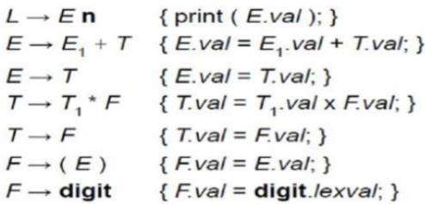
Postfix SDT implementing Desk Calculator SDD

Slide 21

Parser stack implementation of Postfix SDT’s
Consider production: A->XYZ, in which X.x is an attribute of X.
Parser stack contains a field for a grammar symbol (or parse state) and below it an (synthesized) attribute field. It now can be reduced.

Slide 22
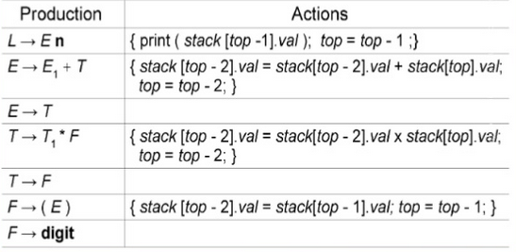
Implementing desk calculator on a bottom up parsing stack

Slide 23
SDT and parse tree with actions embedded
Any SDT can have action inside production and can be implemented as follows:
1. Ignoring the actions, parse the input and produce a parse tree as a result.
2. Then, examine each interior node N, say one for production A -> α. Add additional children to N for the actions in α, so the children of N from left to right have exactly the symbols and actions of α.
3. Perform a preorder traversal of the tree, and as soon
as a node labeled by an action is visited, perform that action.

Slide 24
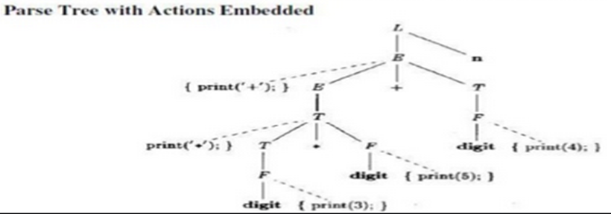
Parse tree with actions embedded for 3*5+4 to +*354
1) L -> En
2) E -> {print(‘+’); } E1+T
3) E -> T
4) T -> { print(‘*’); } T1*F
5) T -> F
6) F -> (E)
7) F-> digit { print(digit.lexval); }
SDT printing prefix
form of expression
than evaluating it.
Impossible to implement
as it has to print before
knowing if symbols appear
If we visit the nodes in preorder we get prefix form of the expression +*354
(root left right).

Slide 25
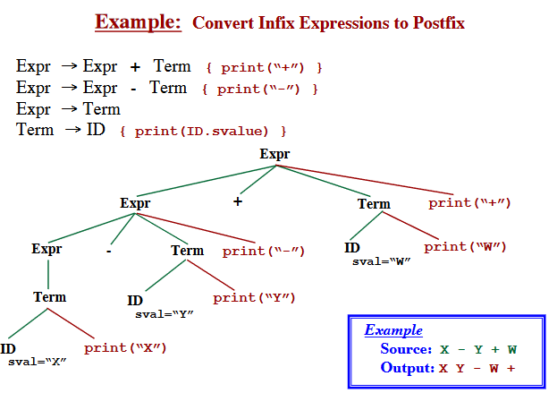
SDT for Infix to Postfix conversion
;
;
;

Slide 26
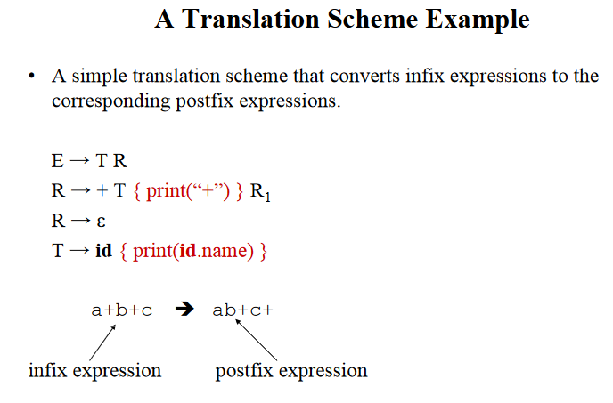
;
;

Slide 27
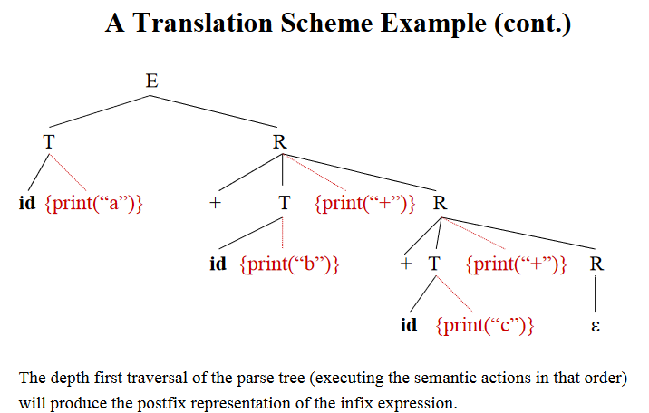
;

Slide 28
SDT for Eliminating left recursion& infix to postfix conversion
Example: 2+3+1 => 23+1+
E->E+T {print (‘+’) ;}| T
T-> 0|1|…|9
On eliminating left recursion :
E->TP
P->+T{print (‘+’);}|P
P->ϵ
T->0 {print (‘0’); }
.
.
T->1 {print (‘1’);}
E
T
P
P
+
2 {print (‘2’);}
T {print(‘+’);}
ϵ
T {print(‘+’);}
3 {print(‘3’);}
1 {print(‘1’);}
Notes:
A->Ax| y removing left recursion here means,
A->yA’
A’->xA’ | e here e=epsilon

